Slide 1


Instrumental Design & Validation Post-completion Global Health Experience (GHE) Participant Survey
Yi Chen
Richard Raker, Sophie Cohn, and Madhabi Chatterji

Slide 2
Phase 1: specify the assessment context
Background
There is increasing demand among medical students and resident physicians in North America to participate in a global health experience (GHE) during their medical training.
GHE refers to an international trip during which medical trainees travel abroad to provide clinical or educational services in high need regions.
Consequently, many medical education institutions have developed pre-departure training programs (for trips to be taken both through home institutions or through independent non-degree organizations) aimed at helping participants prepare for the trip (e.g., addressing or making the plan for the potential risks).
However, high-quality pre-departure training programs for medical trainees are unavailable consistently in reality. This issue has not yet been adequately addressed by the governing bodies of American medical education.

Slide 3
Phase 1: specify the assessment context
Structure of Assessment
The whole training program evaluation assessment contains three separate surveys:
pre-departure GHE participant survey (PS-TP1),
post-completion GHE participant survey (PS-TP2), and
end of year GHE director survey (PD-EOY) --- potential.
Together, the assessment follows a multi-stage, iterative assessment design process. This document focus on PS-TP2.

Slide 4
Phase 1: specify the assessment context
Purpose
PS-TP2 aims at screening the GHE participants for the level of satisfaction with the training program support from a retrospective view.
promoting the development of the training program,
identifying the needs from program participants,
exploring the optimal practice guidelines for similar programs.
Primary User
pre-departure training program developers and Anesthesiology residency program directors

Slide 5
Phase 1: specify the assessment context
Population
The population in this survey is the Anesthesia residents in the U.S. and Canada. They have participated in pre-departure training programs (both from the home institutions or independent non-degree organizations) and have global health work experience in the two weeks.
Unit of Analysis
Individual
Construct
The subjective perception about the satisfaction with the training program support for GHE (psychological construct: Attitudinal).
This construct is measured in multiple domains.

Slide 6
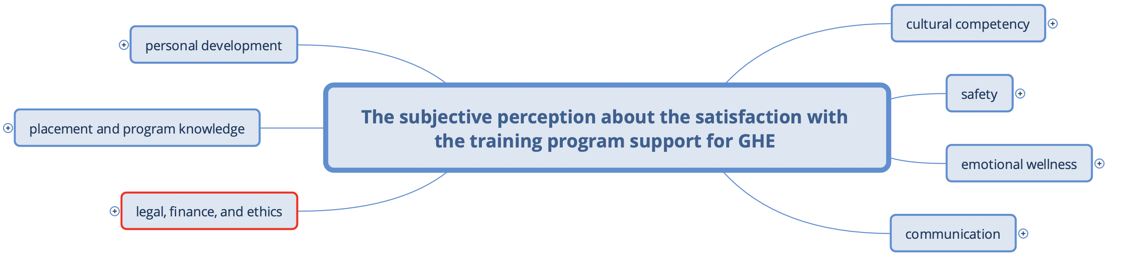
Phase 2: specify the assessment operations

Slide 7
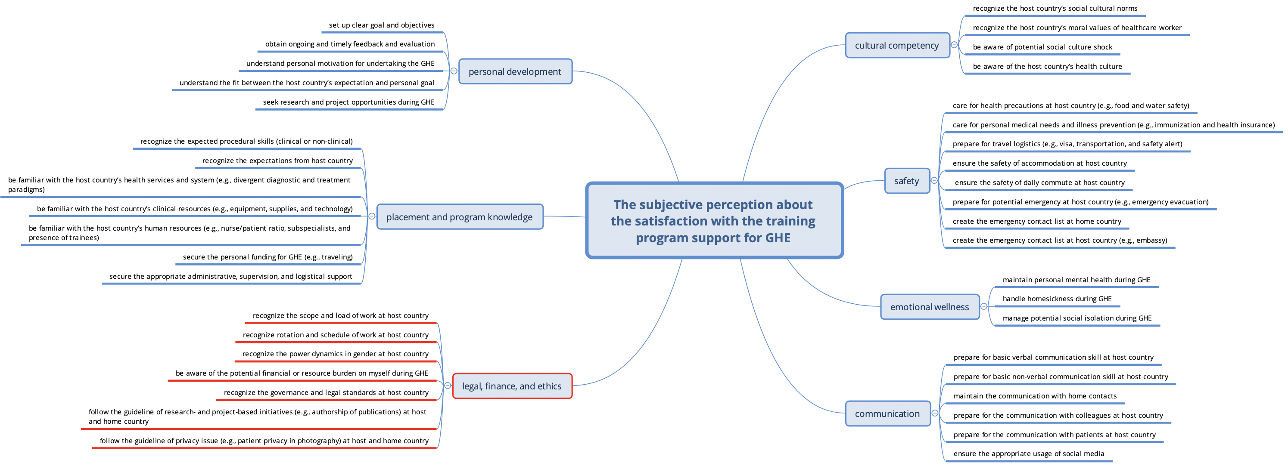
Phase 2: specify the assessment operations

Slide 8
Phase 2: specify the assessment operations
Based on the experience during the GHE trip, participants express satisfaction with support from the training program about legal, finance, and ethics issues . (affective). Sub-indicators: participants express satisfaction with support from the training program about in terms of 5.1: recognizing the scope and load of work at host country; 5.2: recognizing rotation and schedule of work at host country; 5.3: recognizing the power dynamics in gender at host country; 5.4: being aware of the potential financial or resource burden on myself during GHE; 5.5: recognizing the governance and legal standards at host country; 5.6: following the guideline of research- and project-based initiatives (e.g., authorship of publications) at host and home country 5.7: following the guideline of privacy issue (e.g., patient privacy in photography) at host and home country; | Related Literature 1, 2, 3, 5, 6, 7, 10, 13, 14, 21, 22, 24, 26, 27, 29, 30, 31, 33, 37, 41, 45, 46, 49, 50, 51, 54

Slide 9
Phase 2: specify the assessment operations
Assessment condition
The instrument will be administered via a computerized questionnaire using digital tools (e.g., TC Qualtrics or Google Form) without time limitation. However, we recommend the survey be completed at one time.
The survey should be sent to the trainees by email after they finished their trip. All the respondents should finish their survey within two weeks after we send the survey.

Slide 10
Phase 3: design the instrument
Part 1. Before completing the survey, please provide us with the following information:
Name:
Major of Study:
Length of stay:
Country and City:
Clinical setting (clinic or hospital):
The predeparture training program you attend:

Slide 11
Phase 3: design the instrument
Part 2. Please respond to the following questions regarding your satisfaction with the training program support for GHE.
I2 (safety): Looking back on the program orientation and supports and based on your experience during the GHE, how satisfied are you with the following supports?
Specific Indicator | Very Unsatisfied | Unsatisfied | Not certain | Satisfied | Very Satisfied | Not applicable
Preparation in preventing crime at host country
Preparation in being aware of the host country’s health precautions (e.g., food and water safety)
Preparation in caring for personal medical needs and illness plan (e.g., immunization and health insurance)
Preparation in travel logistics (e.g., visa, transportation, and safety alter)
Preparation in ensuring the safety of accommodation and commute at host country
Preparation in the emergency at host country (e.g., civil unrest and natural disaster)
Preparation in creating the emergency contact list at home and host country

Slide 12
Phase 3: design the instrument
Part 3. Open-questions
What are your goals for the GHE trip? What you achieve and what not?
In general, what is the most important thing for preparation?
What is the most useful information that you learn from the training program?
In general, what is the most challenging thing for you during the experience?

Slide 13
Phase 4: validate the measurement
Type of Validity Evidence | Validation Question | When to collect | Methods
Content-based validity | To what extend does the evidence show Content Relevance and Content Representativeness of the construct, domain, and indicators on Perceived Satisfaction. | Soon after the design of instruments and items | 1. Follow the rule of domain sampling when design the instrument 2. External expert review through interview 3. Previous Participants and director review through interview 4. Content validity index (e.g., content validity index and kappa coefficients) 5. checklist (ensure to follow the domain sampling method)
Internal Structure and Dimensionality Validity | To what extent are the analyses of the item response data consistent with the theory and the specification of domains? | After the instrument finished the first iteration and has been proved with content validation | PCA, CFA, EFA (compare the statistical structure of data we collect with the theory structure of the contrast, domain, and indicators)
Criterion-related Validity | To what extent, do the scores of the scales tapping construct domains predict the future trainees’ satisfaction levels? | After content validation, internal factor structure evaluations, and convergent and discriminant validity tests are completed | Correlation and regression

Slide 14
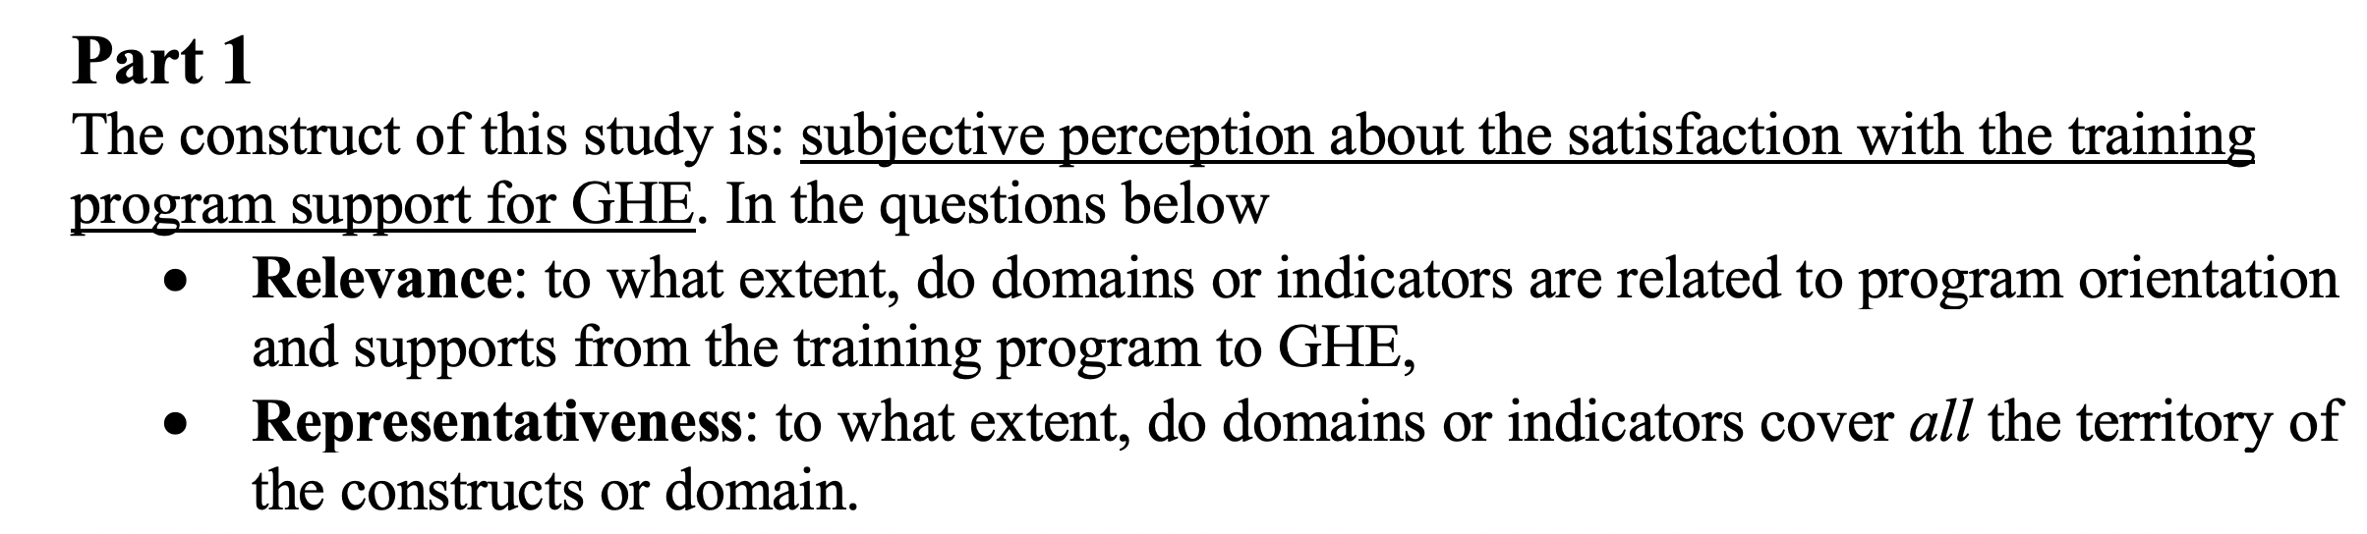
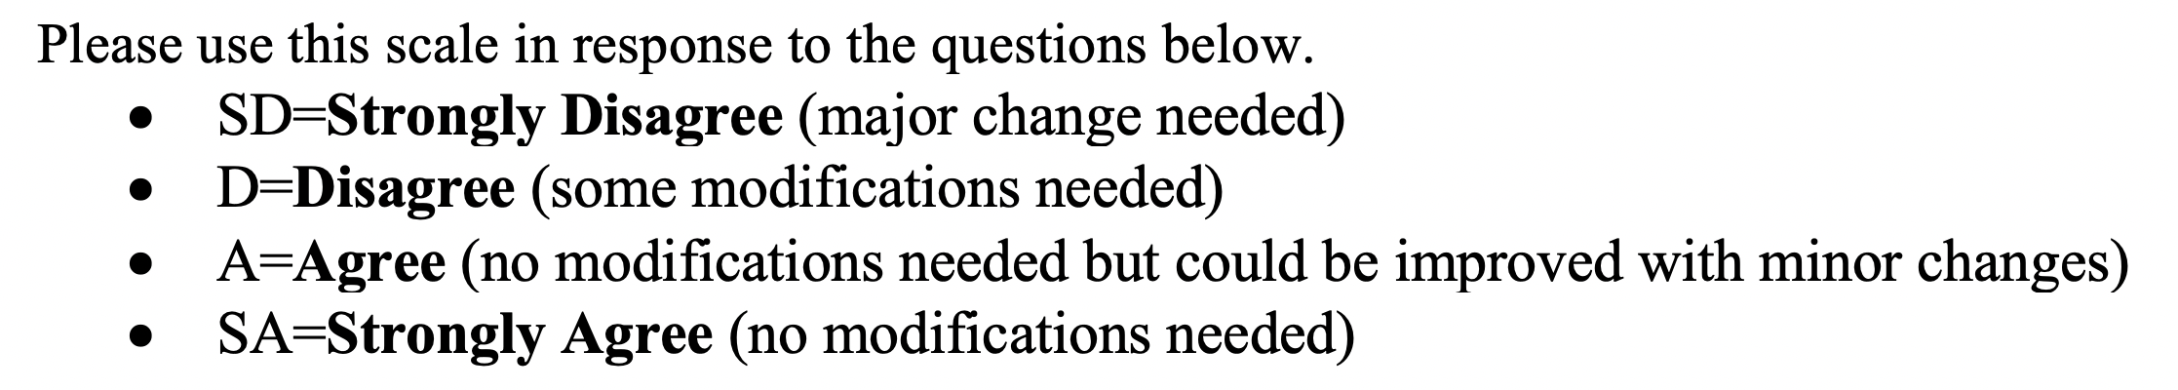
Phase 4: validate the measurement --- Content Validation Plan
Domains
The seven domains appropriately address the construct in terms of relevance. cultural competency; safety; emotional wellness; communication; ethics; placement and program knowledge; personal development. | SD | D | A | SA
Suggestion for modification (i.e., any domain is not relevant to the construct or need modification?)
The seven domains appropriately address the construct in terms of representativeness. cultural competency; safety; emotional wellness; communication; ethics; placement and program knowledge; personal development. | SD | D | A | SA
Suggestion for modification (i.e., any domain is ignored?)

Slide 15
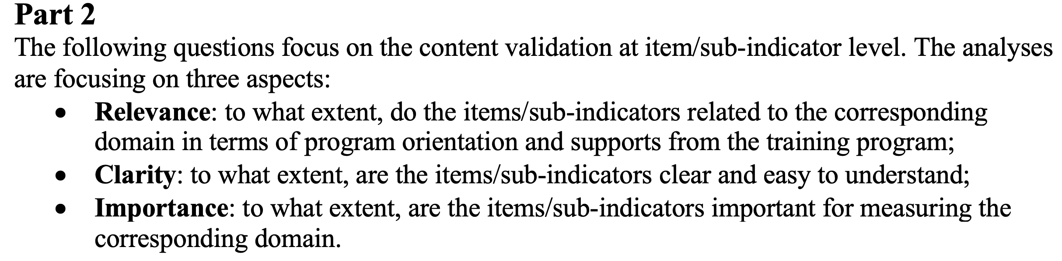
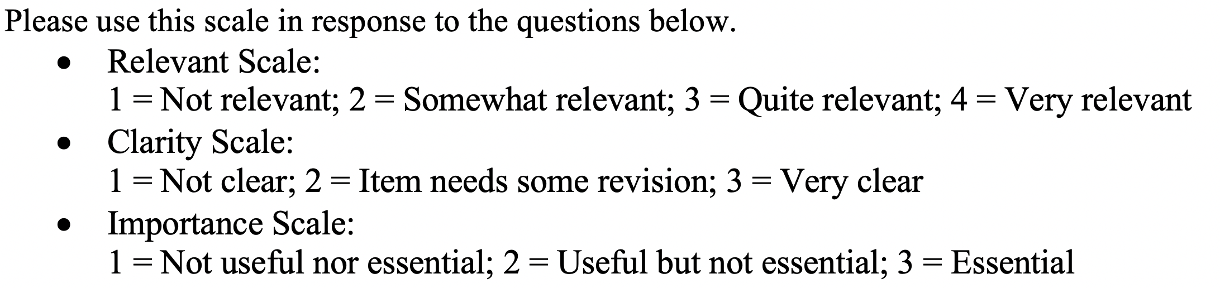
Phase 4: validate the measurement --- Content Validation Plan
Items/Sub-indicators validation
1. Cultural Competency Looking back on the program orientation and supports, and based on your experience during the GHE, how satisfied are you with the following supports?
Items | Relevance (1 – 4) | Clarity (1 – 3) | Importance (1 – 3)
1.1: preparation in recognizing host country’s cultural norms
1.2: preparation in recognizing host country’s moral value
1.3: preparation in dealing with social culture shock
1.4: Preparation in being aware of host country’s medical and health culture (e.g., patient autonomy)
Suggestion for modification

Slide 16
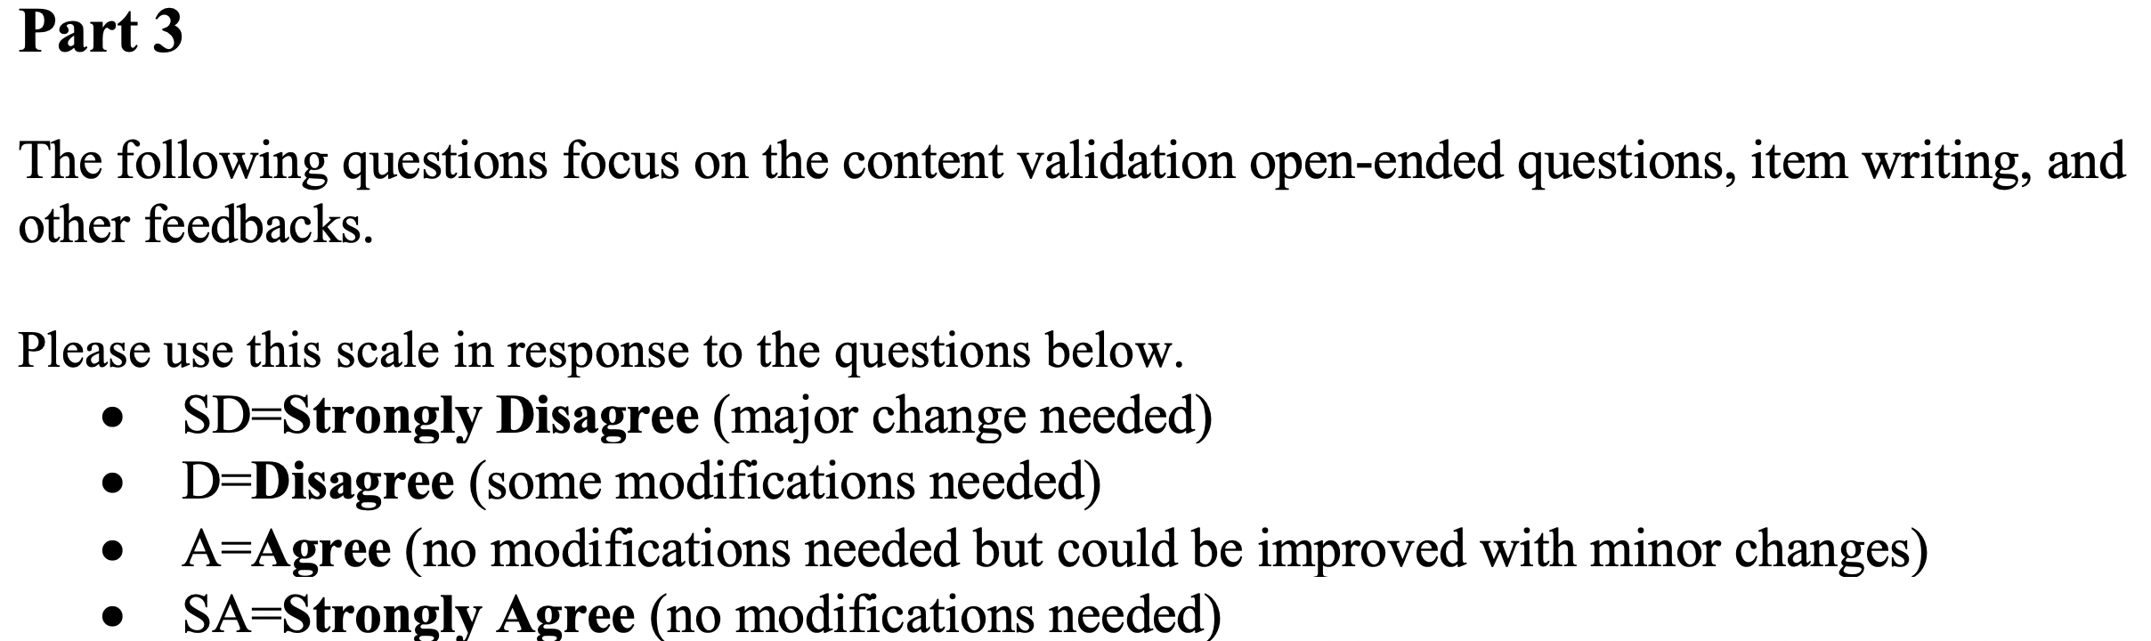
Phase 4: validate the measurement --- Content Validation Plan
Open-end Questions
The open-ended items appropriately address the construct in terms of relevance. | SD | D | A | SA
Suggestion for modification (i.e., any sub-indicator that are not relevant to the domain or need modification?)
The open-ended items are clear in wording, format, or directions | SD | D | A | SA
Suggestion for modification

Slide 17
Phase 4: validate the measurement --- Result
Item Relevance
Item Index | Expert 1 | Expert 2 | Expert 3 | Expert 4 | Experts in Agreements | CVI
1.1 | 4 | 3 | 4 | 4 | 4 | 1.00
1.2 | 4 | 4 | 4 | 4 | 4 | 1.00
1.3 | 4 | 3 | 4 | 4 | 4 | 1.00
1.4 | 4 | 4 | 2 | 4 | 3 | 0.75
2.1 | 3 | 4 | 3 | 4 | 4 | 1.00
2.2 | 4 | 4 | 4 | 4 | 4 | 1.00
2.3 | 4 | 4 | 4 | 4 | 4 | 1.00
2.4 | 4 | 4 | 4 | 4 | 4 | 1.00
2.5 | 4 | 4 | 4 | 4 | 4 | 1.00
2.6 | 4 | 4 | 4 | 4 | 4 | 1.00
2.7 | 3 | 4 | 4 | 4 | 4 | 1.00
3.1 | 2 | 4 | 4 | 4 | 3 | 0.75
3.2 | 4 | 4 | 4 | 4 | 4 | 1.00
3.3 | 4 | 4 | 4 | 4 | 4 | 1.00
4.1 | 2 | 2 | 4 | 4 | 2 | 0.5
4.2 | 4 | 4 | 4 | 4 | 4 | 1.00
4.3 | 4 | 4 | 4 | 4 | 4 | 1.00
4.4 | 4 | 4 | 4 | 4 | 4 | 1.00
4.5 | 4 | 4 | 2 | 3 | 3 | 0.75

Slide 18
Continue
Item Index | Expert 1 | Expert 2 | Expert 3 | Expert 4 | Experts in Agreements | CVI
5.1 | 2 | 4 | 4 | 4 | 3 | 0.75
5.2 | 2 | 4 | 4 | 4 | 3 | 0.75
5.3 | 4 | 4 | 2 | 4 | 3 | 0.75
5.4 | 4 | 4 | 4 | 3 | 4 | 1.00
5.5 | 4 | 4 | 3 | 4 | 4 | 1.00
5.6 | 2 | 4 | 4 | 2 | 2 | 0.50
5.7 | 2 | 4 | 4 | 4 | 3 | 0.75
5.8 | 4 | 4 | 4 | 4 | 4 | 1.00
5.9 | 2 | 4 | 1 | 2 | 1 | 0.25
5.10 | 1 | 4 | 4 | 2 | 2 | 0.50
6.1 | 4 | 4 | 4 | 4 | 4 | 1.00
6.2 | 1 | 4 | 1 | 4 | 2 | 0.50
6.3 | 2 | 4 | 4 | 3 | 3 | 0.75
6.4 | 3 | 4 | 4 | 4 | 3 | 0.75
6.5 | 4 | 4 | 4 | 4 | 4 | 1.00
6.6 | 4 | 4 | 4 | 4 | 4 | 1.00
6.7 | 4 | 4 | 4 | 4 | 4 | 1.00
6.8 | 3 | 4 | 4 | 4 | 4 | 1.00
7.1 | 4 | 4 | 4 | 4 | 4 | 1.00
7.2 | 4 | 4 | 4 | 4 | 4 | 1.00
7.3 | 3 | 4 | 4 | 4 | 4 | 1.00
7.4 | 3 | 4 | 4 | 4 | 4 | 1.00
7.5 | 3 | 4 | 4 | 3 | 4 | 1.00

Slide 19
Item Index | Average Clarity Score | Average Importance Score
1.1 | 2.25 | 2.75
1.2 | 1.75 | 2.5
1.3 | 2.25 | 2.75
1.4* | 2.25 | 2.75
2.1 | 1.5 | 2.75
2.2 | 2.5 | 3
2.3 | 3 | 3
2.4 | 3 | 3
2.5 | 2.75 | 3
2.6 | 3 | 3
2.7 | 2.5 | 3
3.1* | 2 | 2.75
3.2 | 3 | 3
3.3 | 3 | 3
4.1* | 2.25 | 2.75
4.2 | 2.75 | 3
4.3 | 2.25 | 2.75
4.4 | 3 | 3
4.5* | 2.75 | 2.75
5.1* | 2.25 | 2.75
5.2* | 2 | 2.75
5.3* | 2.25 | 2.5
5.4 | 2.25 | 2.5
5.5 | 2.25 | 2.75
5.6* | 1.5 | 1.75
5.7* | 2 | 2.25
5.8 | 3 | 3
5.9* | 1.5 | 1.5
5.10* | 1.5 | 1.5

Slide 20
Phase 4: validate the measurement --- Revise
4.1 Preparation in formal and informal language at host country
Expert comment 1: Is a Residency Program supposed to prep or prepare a trainee for “formal language training” in a short period of time? Is this realistic?
➔ remove the item?
Expert comment 2: What does “formal and informal language at host country mean”? verbal and non-verbal communications?
➔ change formal and informal into verbal and non-verbal?
Expert comment 3: Double barreled could be understand one or the other (both important)
➔ separate the item into two independent item?
average clarity score: 2.25
average importance score: 2.75

Slide 21
Next Steps
content validation with the new version of survey

Slide 22
Reference
1. Kalbarczyk, A., Nagourney, E., Martin, N. A., Chen, V., & Hansoti, B. Are you ready? A systematic review of pre-departure resources for global health electives. BMC medical education, 2019;19(1), 166.
3. Peluso, M. J., Kallem, S., Elansary, M., & Rabin, T. L. (2018). Ethical dilemmas during international clinical rotations in global health settings: findings from a training and debriefing program. Medical teacher, 40(1), 53-61.
5. Murphy T., Mackenzie A., Waysome B., Guy-walker J., Palmer R, Rose E. A., & Rigby J, Lab. A Mixed methods study of health worker migration from Jamaica. Human Resources for Health, 2016;14:36.
6. Daniel H. de Vries, Steinmetz S., & Kea G. T. Does migration pay off for foreign born migrant health workers? An exploratory analysis using the global Wage Indicator dataset. Human Resources for Health, 2016;14:40.
7. Gregory S., & Demartini C. Satisfaction of doctors with their training: evidence from UK. BMC Health Services Research, 2017;17:851.
10. Crump JA, Sugarman J, Barry M, Bhan A, Gardner P, & Koplan JP, et al. Ethics and best practice guidelines for training experiences in global health. Am J Trop Med Hyg, 2010; 83:1178–82.
13. Landau S. Do it yourself medical mission. A step-by-step approach. N C Med J. 2001; 62:140–6. Available from: http://www.ncbi.nlm.nih.gov/pubmed/11370316
14. Wilson JW, Merry SP, & Franz WB. Rules of Engagement: the principles of underserved Global Health volunteerism. AJM, 2012;125:612–617. Available from: Doi: https://doi.org/10.1016/j.amjmed.2012.01.008.
21. Sasha H. C., Gitanjli A., Traci W., & Risa M. H., Evaluation of a Structured Predeparture Orientation at the David Geffen School of Medicine’s Global Health Education Programs, Am. J. Trop. Med. Hyg. 2016; 94(3):563–567, doi:10.4269/ajtmh.15-0553
22. Nicole E., Michael B. P., Sabrina B., & Natalie M., et al. Global Health: Preparation for Working in Resource-Limited Settings, PEDIATRICS, 2017;140: e20163783.
24. Hansoti B, Douglass K, Tupesis J, et al. Guidelines for safety of trainees rotating abroad: consensus recommendations from the Global Emergency Medicine Academy of the Society for Academic Emergency Medicine, Council of Emergency Medicine Residency Directors, and the Emergency Medicine Residents’ Association. Acad Emerg Med. 2013;20(4):413–420
26. Hansoti B, Weiner SG, Martin IBK, et al. Society for Academic Emergency Medicine’s Global Emergency Medicine Academy: global health elective code of conduct. Acad Emerg Med. 2013;20(12):1319–1320
27. Lumb A, Murdoch-Eaton D. Electives in undergraduate medical education: AMEE guide no. 88. Med Teach. 2014;36(7):557–572
29.Asgary R, Junck E. New trends of short-term humanitarian medical volunteerism: professional and ethical considerations. J Med Ethics. 2013;39(10):625–631
30. Chase J, Evert J. Global Health Training in Graduate Medical Education: A Guidebook. San Francisco, CA: Global Health Education Consortium; 2011
31. Association of Faculties of Medicine of Canada Global Health Resource Group; Canadian Federation of Medical Students Global Health Program. Preparing medical students for electives in low-resource settings: a template for national guidelines for pre-departure training. 2008. Available at: www.old.cfms.org/downloads/ Pre-Departure Guidelines Final.pdf. Accessed June 9, 2016
33. Kamat D, Armstrong RW; Association of Medical School Pediatric Department Chairs, Inc. Global child health: an essential component of residency training. J Pediatr.2006;149(6):735–736
37. Balandin S, Lincoln M, Sen R, Wilkins DP, Trembath D. Twelve tips for effective international clinical placements. Med Teach. 2007;29(9):872–877
41. Crump JA, Sugarman J; Working Group on Ethics Guidelines for Global Health Training (WEIGHT). Ethics and best practice guidelines for training experiences in global health. Am J Trop Med Hyg. 2010;83(6):1178–1182
45. Brent A, Davidson R, Seale A, eds. Oxford Handbook of Tropical Medicine. Oxford, United Kingdom: Oxford University Press; 2014
46. Lukolyo H, Rees CA, Keating EM, et al. Perceptions and expectations of host country preceptors of short-term learners at four clinical sites in sub-Saharan Africa. Acad Pediatr. 2016;16(4):387–393
49. Martin BM, Love TP, Srinivasan J, et al. Designing an ethics curriculum to support global health experiences in surgery. J Surg Res. 2014;187(2):367–370
50. Chase J, Evert J. Global Health Training in Graduate Medical Education: A Guidebook. San Francisco, CA: Global Health Education Consortium; 2011
51. Suchdev P, Ahrens K, Click E, Macklin L, Evangelista D, Graham E. A model for
54. John A. Crump, Jeremy Sugarman, & the Working Group on Ethics Guidelines for Global Health Training (WEIGHT) Global Health Training: Ethics and Best Practice Guidelines for Training Experiences in Global Health. Am. J. Trop. Med. Hyg. 2010;83(6):1178–1182

Slide 23
Thank you

